Slide 1
Engineering Interactive Visual Interfaces for Data Science (“The CS Data Vis Class”)
xkcd

Slide 2
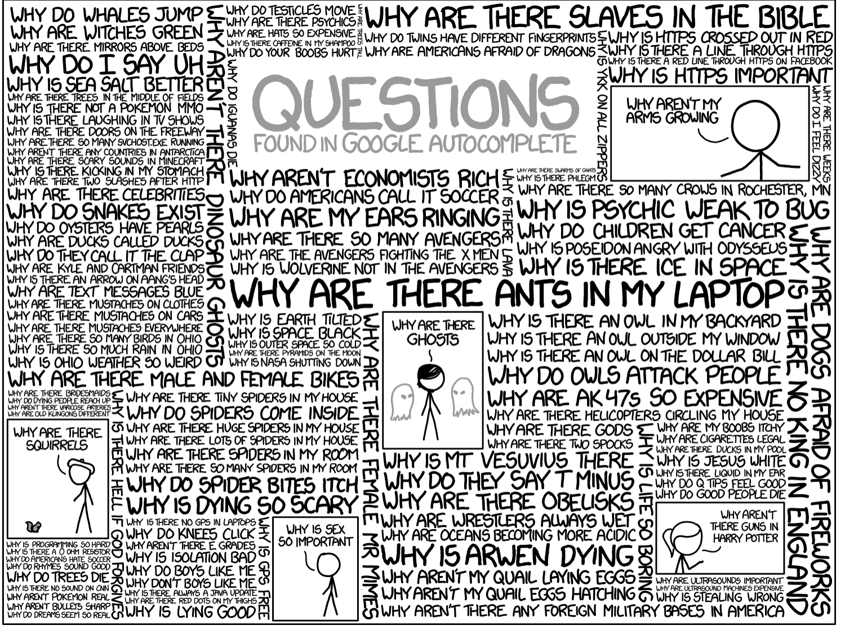
Questions?

Slide 3
Spatial positioning
We learned that position is one of the best visual channels to use in encoding data
So far, we have positioned elements using scales-
Linear scale to position elements based on a quantitative data attribute
Banded scale to position elements based on a qualitative data attribute
What if we need something more complex

Slide 4
Layout help needed!
Stacks, pie charts
Positions of the bars or wedges depends on the positions of other elements
Graph data: Hierarchical / Trees, Network data
Position of elements related to edges
Position of elements related to neighbors

Slide 5
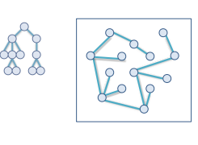
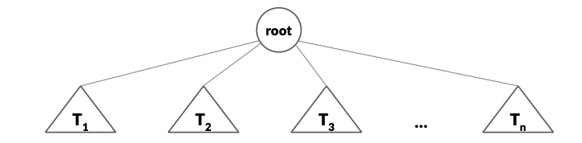
Let’s consider trees
What is a tree?
A graph with no cycles
A graph with a root node, and 0-n subtrees
It is a sub-type of graph data

Slide 6
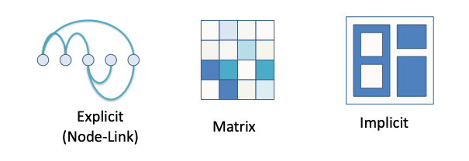
How can we present trees?
Three types of graph representation

Slide 7
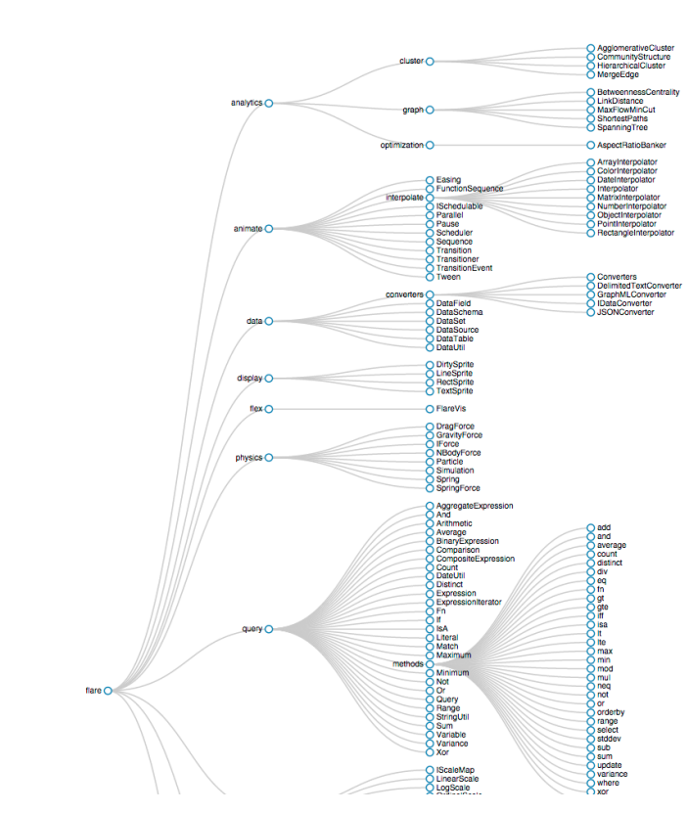
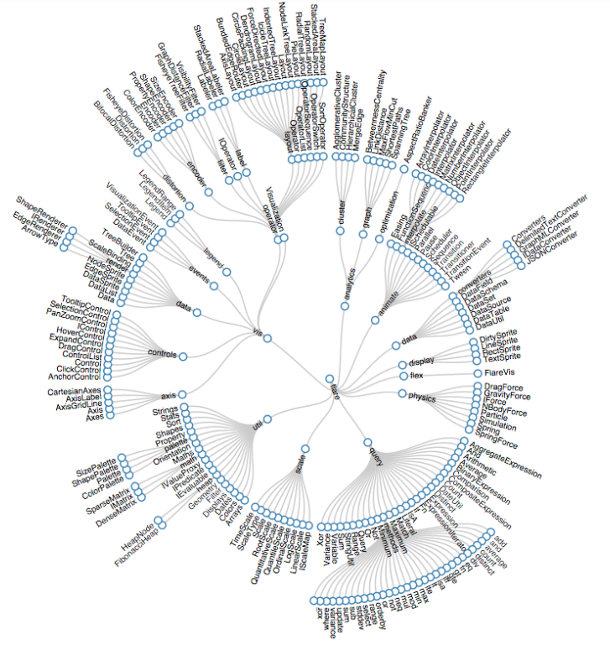
Explicit representation of a tree
Tradeoffs?
What if you wanted to show the size of each node
ex. Directory size
Interactions? Let’s think if some ways to interact. What would these allow a user to learn?

Slide 8
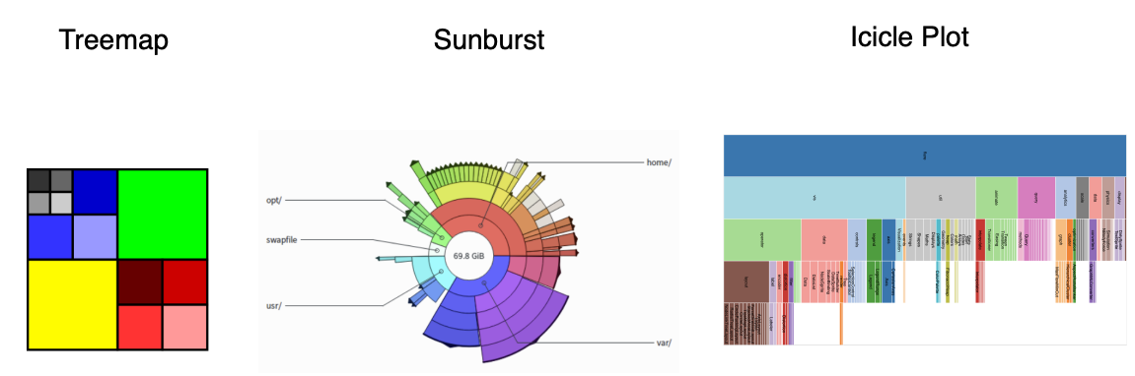
Implicit layout options

Slide 9
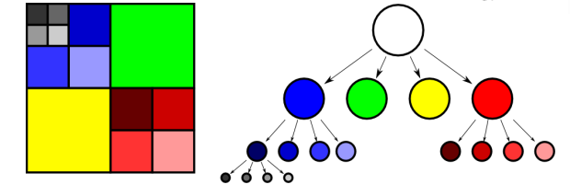
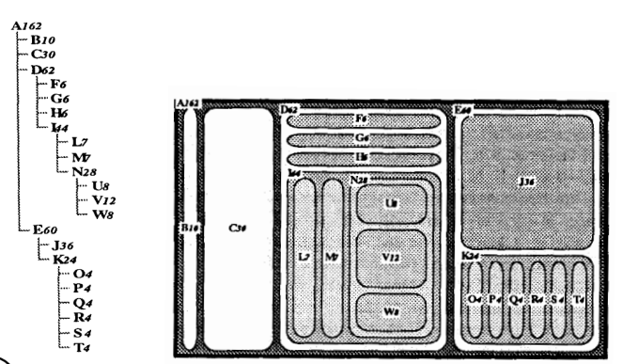
Treemap

Slide 10
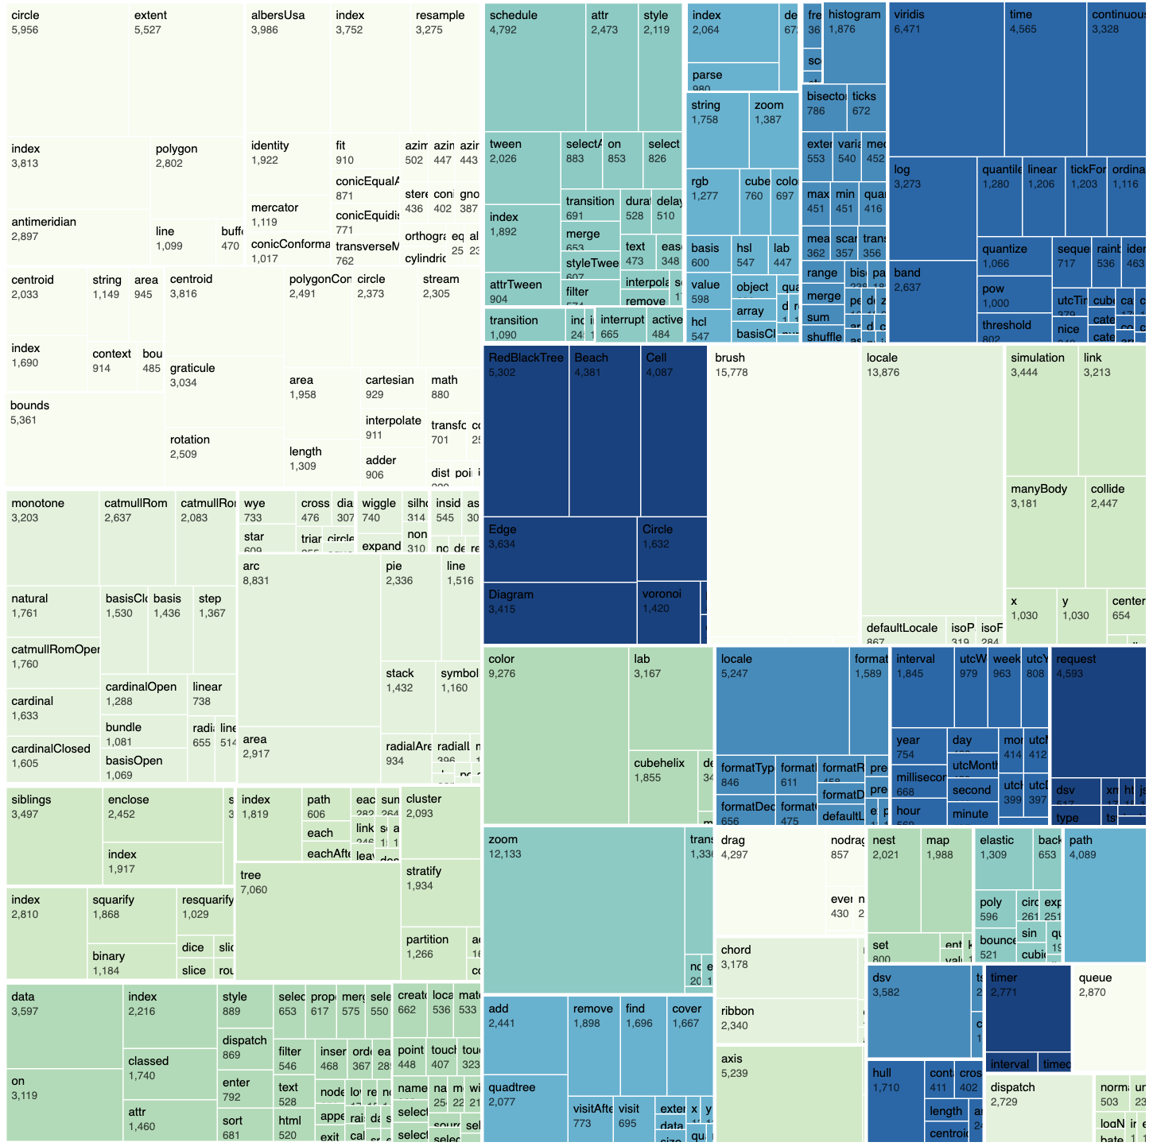
Treemap example
D3 code base structure
And bytes (size of region)
Thoughts? Pro’s /Con’s

Slide 11
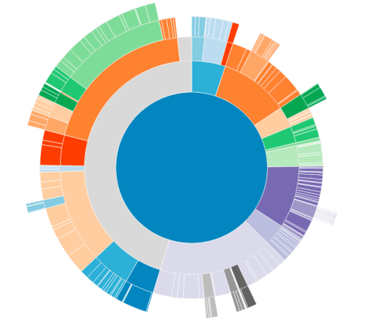
Sunburst: Radial layout
Leaves are on the outside
Inside is near the root of the tree
Size of the node can be shown

Slide 12
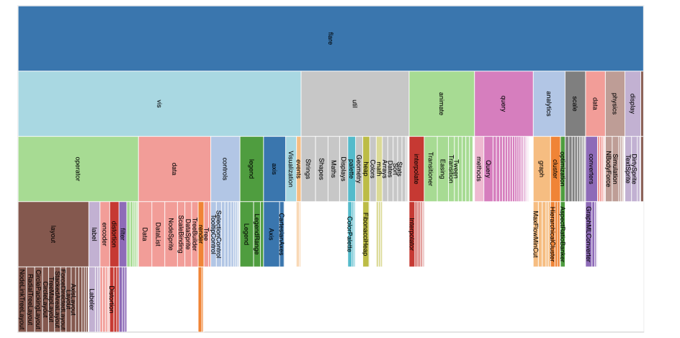
Icicle Plot

Slide 13
Differences? Pro’s? Con’s?

Slide 14
Differences? Pro’s? Con’s?
Only leaves are visible
Inner leaves and nodes visible

Slide 15
Implicit Representations
Pro’s:
Space efficient
Scale up to large graphs
Show additional data (e.g., size)
Con’s:
Position encodes the edges , so this channel can’t be used for anything else
Edge data (eg. Weighted edges) can’t be shown

Slide 16
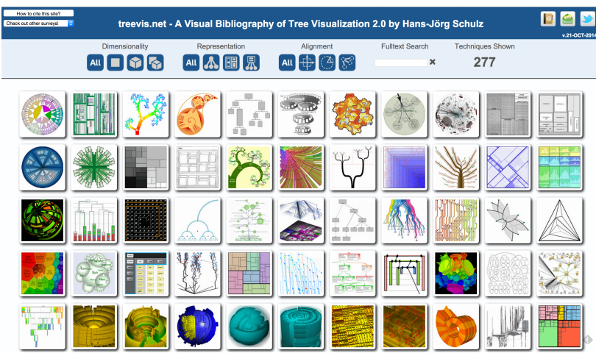
Tree visualization reference

Slide 17
So, how do we compute these layouts?
Tutorial 12 on Canvas
1. Transform the raw data into an appropriate format for the layout generator
2. Apply a layout generator takes the transformed data, and produces an intermediate format very close to what will be visualized
examples- start and end points for stacked rectangles, a path to draw for an arc
3. Use this intermediate data to create svg elements within the DOM
Like usual- append or join…

Slide 18
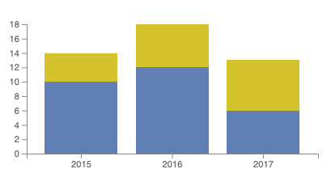
Stacked bar charts
Original data:
const data = [ { 'year': 2015, 'milk': 10, 'water': 4 }, { 'year': 2016, 'milk': 12, 'water': 6 }, { 'year': 2017, 'milk': 6, 'water': 7 } ];
Transformed data d3 can understand: NA
Intermediate data, ready for svg elements: stacked data:
Create a stacking function:
const stack = d3.stack().keys(['milk', 'water’]);
Call the stacking function on your data:
const stackedData = stack(data);
Output is a set of values that are stacked
Ex. Milk{ 2015: 0 to 10,….}. Water{ 2015: 10 to 14 )
Apply svg’s to this intermediate data
Make a rect from 0-10 and from 10-14

